Slide 1
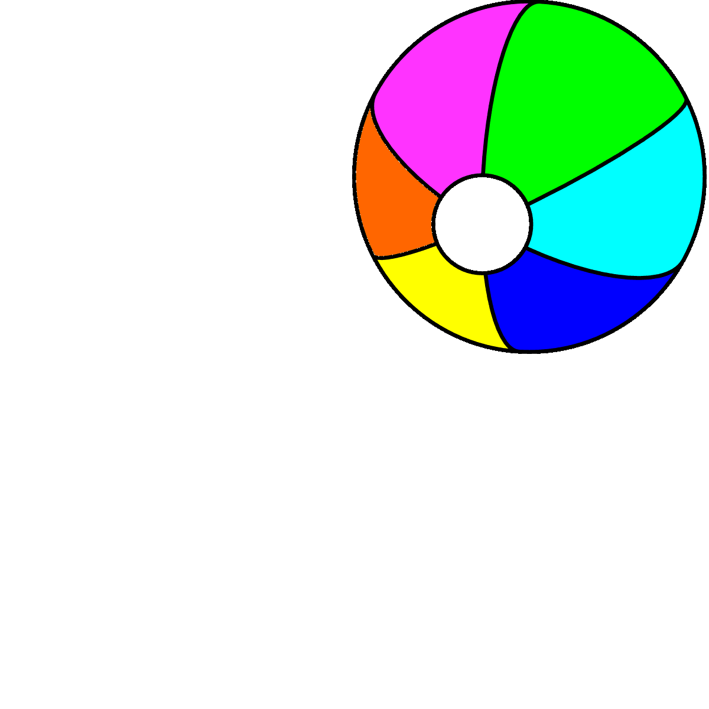
Where’s the ball?
Unit 5
Lesson 6

Slide 4
It’s play time!

Slide 5
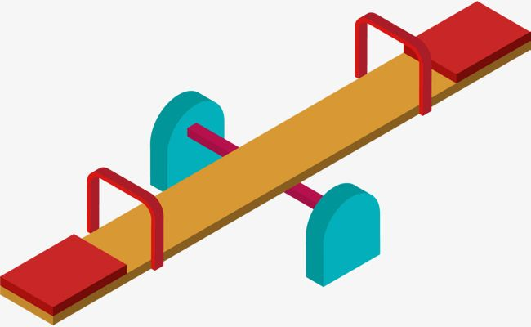
You can’t play with me alone.
I am long.
seesaw
I can throw you up.

Slide 6
My hair changes color.
I am tall.
I make wood.
tree

Slide 7
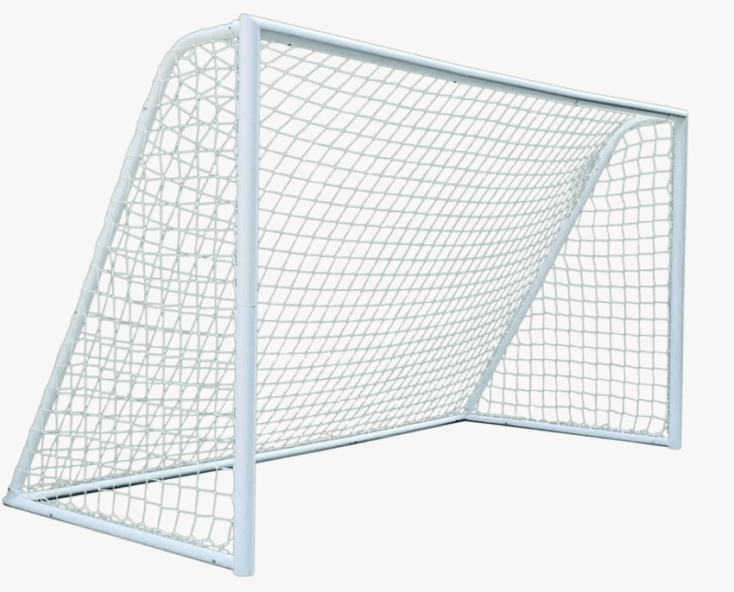
I have four legs .
I made of wood or plastic.
I have drawers.
goal

Slide 8
I can fly.
I’m made of plastic.
You throw me hard.
Frisbee

Slide 9
I may live indoors.
I may live in the playground.
You must climb to play with me.
slide

Slide 10
There’s water in me.
I am very big.
Chairs are around me.
pool

Slide 11
Watch a film

Slide 13
Listen and point

Slide 15
Read

Slide 16
Where’ ……………..?
the ball
The ball is on the slide.

Slide 17
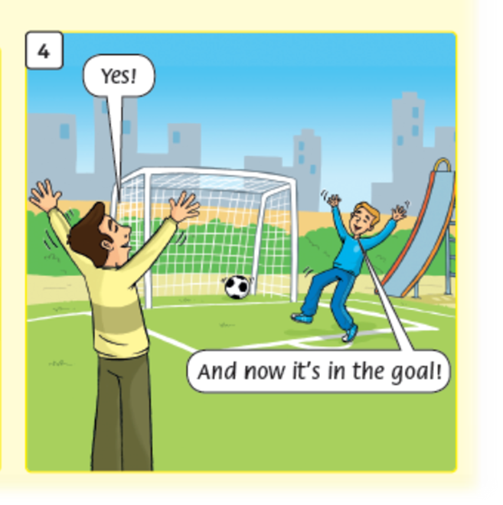
Where’ ……………..?
the ball
The ball is in the goal.

Slide 18
Listen and repeat

Slide 20
Work in pairs

Slide 22
Workbook time!!!

Slide 23
✗
Take care in the park!

